Slide 1


Weekly Report: Internship Week 1
Rane Steering systems - R&D division
Presented by: Mohnish Raja • 02/06/2025

Slide 2
Task 1 - Disc Spring Washer
Objective:
To design and validate a disc spring washer configuration in a manual steering column’s lever system.

Slide 3
Design Problem - Existing
In a manual steering column, a lever transfers torque to the shaft through a cam mechanism that converts torque into axial force. A disc spring is used to ensure proper engagement and eliminate play.
However, selecting or designing a disc spring that ensures sufficient preload(no play) at low torque while also surviving the high axial loads generated at peak torque (without yielding or flattening) is a critical challenge.
The problem is to validate and modify an existing disc spring that meets these force requirements within the constraints of available space, standard part dimensions, and material limits.

Slide 4
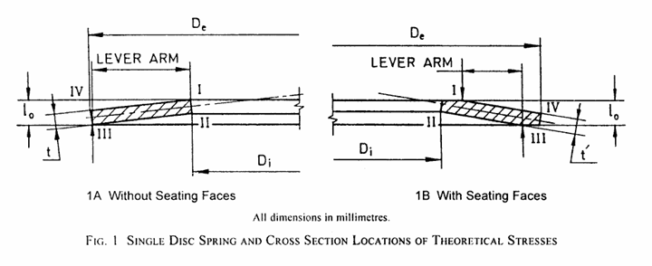
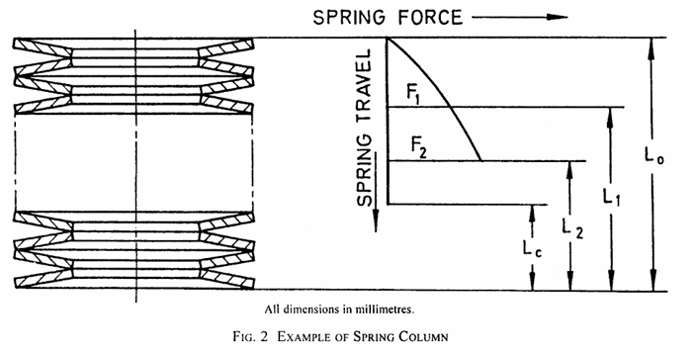
Schematics

Slide 5
Requirements & Constraints
Requirements
Provide an axial force range of 245 N to 495 N corresponding to the torque range of the cam lever.(since the min locking force on the lever is 4kgf and max force applied is constrained to 8kgf)
Washer must have almost unlimited fatigue life under repeated loading.
Max stress in the washer must be within allowable limits.
Constraints
The ID, thickness of the washer is fixed since it was already decided according to several packaging constraints.
Availability and cost of the material

Slide 6
Solution Approach
Analysed the current spring washer dimensions and calculated the spring force, stiffness, max stress induced and the max, min stress of fatigue limits according to ISO standards(IS 12511: 2004).
Proposed arranging both washers in column fashion, i.e. in opposite directions. This will require the same force to compress them but provides more thickness and spring travel.
Modified max spring travel, outer diameter and made sure that it satisfies all the stress limits and given constraints, which was not the case before.

Slide 7
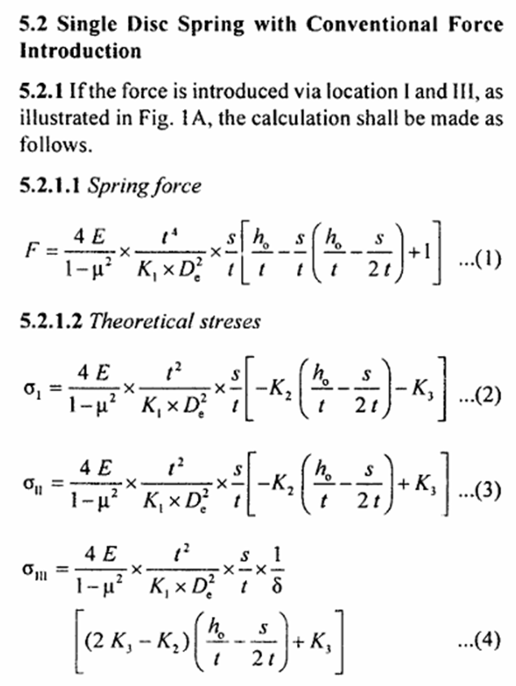
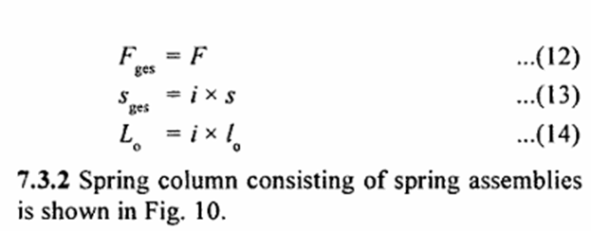
Governing Formulae

Slide 8
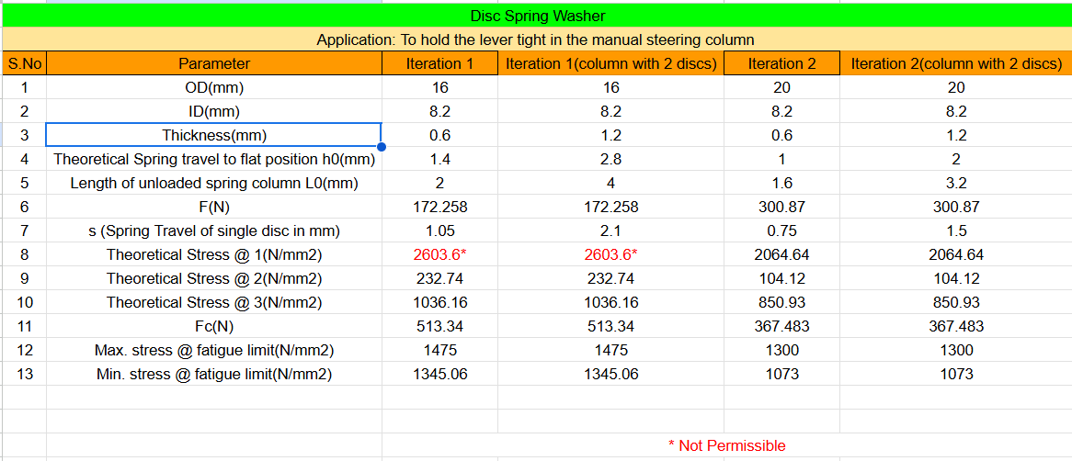
Final Output
Increased OD and decreased max spring travel (h0) reduced the max stress in the washer.
The spring force (F) has increased in the second iteration. Hence iteration 2 is the recommended approach.

Slide 9
Task 2 - Wave Spring Washer
Objective:
To design and validate a wave spring washer configuration in a manual steering column’s lever system.

Slide 10
Design Problem
In a manual steering column, a lever transfers torque to the shaft through a cam mechanism that converts torque into axial force. A wave washer is also used to ensure proper engagement and eliminate play.
Selecting a washer that functions across a defined torque range is a challenge— it must ensure sufficient preload(no play) at low torque while also surviving the high axial loads generated at peak torque (without yielding or flattening).
The problem is to validate and modify an existing disc spring that meets these force requirements within the constraints of available space, standard part dimensions, and material limits.

Slide 11
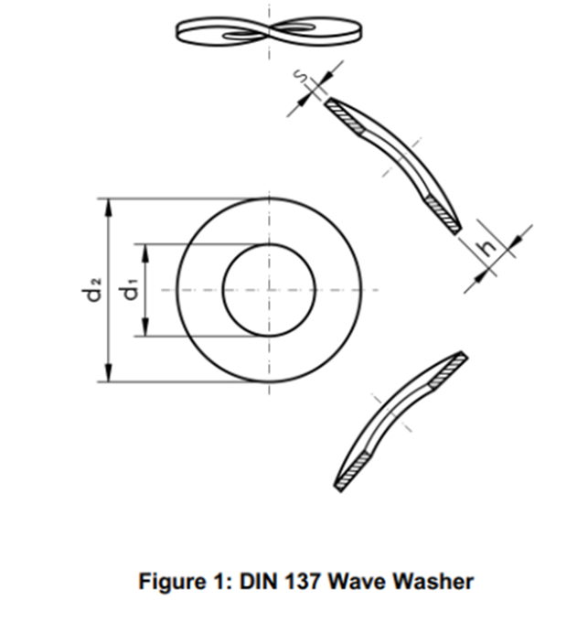
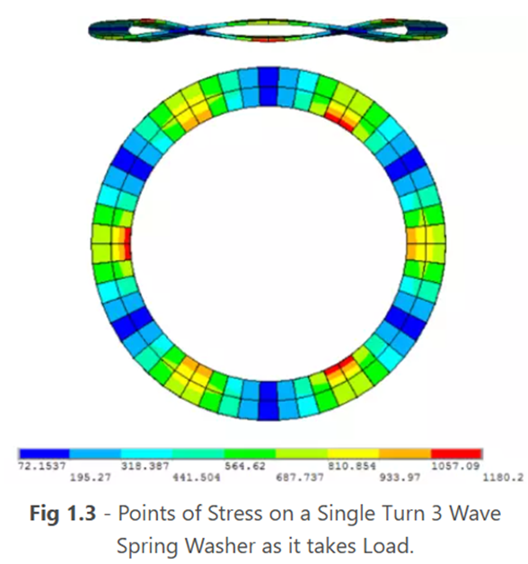
Schematics

Slide 12
Requirements & Constraints
Requirements
Provide an axial force range of 245 N to 495 N corresponding to the torque range of the cam lever.(since the min locking force on the lever is 4kgf and max force applied is constrained to 8kgf)
Washer must have almost unlimited fatigue life under repeated loading.
Max stress in the washer must be within allowable limits.
Constraints
The ID, thickness of the washer is fixed since it was already decided according to several packaging constraints.
Availability and cost of the material

Slide 13
Solution Approach
Analysed the current washer dimensions and calculated the spring rate, max,min stress induced and the max,min stress of fatigue limits and corresponding no of life cycles referring to ISO, DIN standards
Calculated max induced stress, deflections (min, max) by changing parameters like OD, no. of waves since the initial dimensions gave very minimal deflections and high stiffness, which was not favourable.
Calculated the above parameters again when the wave washers were kept in series and parallel.

Slide 14
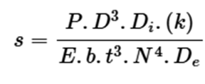
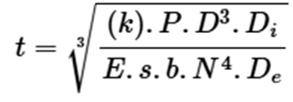
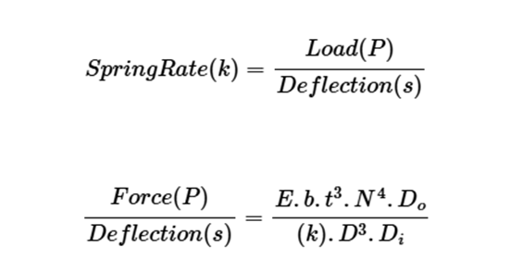

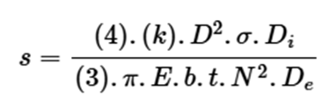
Governing Formulae

Slide 15
Final Output
The stiffness (Spring Rate) of the washers turned out to be very high even in parallel combination, where the same force is required to cause more deflection. The corresponding deflections were also very low, which isn’t favourable.
The maximum induced stress and the max fatigue stress also exceeded the permissible stress limits.
Hence recommended not to use the wave washer for the purpose.

Slide 16
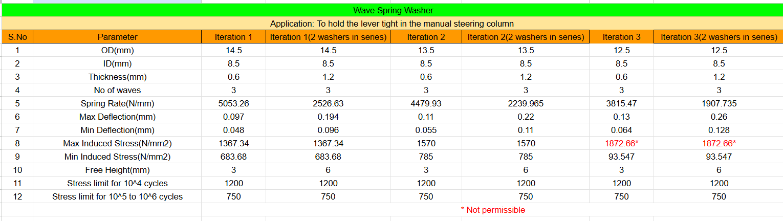
Iterations

Slide 17
Task 3 - Sleeve Design for Column
Objective:
To design a cost-effective, manufacturable, and functional sleeve for the serration shaft of a manual steering column that meets OEM requirements.

Slide 18
Design Problem
In manual steering columns, the serration shaft (exposed between connector and tube) is prone to rust. Since it is raw and exposed, a sleeve must be designed to:
Conceal shaft rust during normal operation and even if the bonnet is open, hide it from the driver.
Compress and expand along with column length changes without resisting collapse.
Survive a radiated temperature of 90° - 100°C without material deformation.
Be compatible with existing column design, vehicle packaging, and OEM assembly processes.

Slide 19
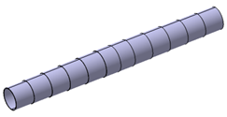
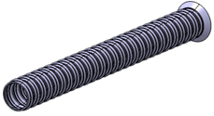
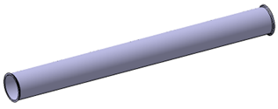
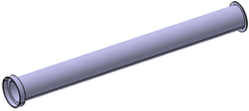
Design Concepts Sketched
Concept 1 - Telescopic sleeve
Concept 2 - Bellow sleeve
Concept 3 - Cylindrical sleeve
Concept 4 - Step Cylindrical sleeve

Slide 20
Requirements & Constraints
Rust Concealment: Sleeve must cover shaft completely to hide corrosion.
Compression Compliance: Should compress as the column shortens and expand back without any resistance.
Crash Safety: Sleeve must tear or compress easily, not oppose column collapse.
Thermal Resistance: No deformation up to 90° to 100°C radiated temperature.
Durability: Should withstand real world vibration and repeated compression.

Slide 21
Requirements & Constraints
Serviceability: Should be easily removable and reinstallable by mechanics.
Ease of Assembly: Both by sleeve supplier and car OEM.
Cost and Procurement: Should be economical and feasible to source.
Manufacturability: Should be easy to manufacture and feasible as well.
Environmental considerations: Low NVH, recyclable materials, no toxic emissions.
Development time shouldn’t be very high.

Slide 22
Approach
Brainstormed four sleeve concepts — telescopic, bellows, cylindrical with flanges, and step cylindrical. Sketched them initially keeping in mind the requirements and feasibility.
Sketching: Created hand-drawn technical sketches to visualize form and movement.
Material Selection: Shortlisted Nylon 6/6, TPE, ABS, and Silicone based on thermal, mechanical, and environmental criteria.

Slide 23
Approach
Sleeve Matrix: Built a detailed comparison table covering 13 aspects relevant to steering column sleeves in car and pickup applications.
Refinement: Updated evaluation criteria based on field usage, supplier feedback, and engineering constraints.
Next Steps: Present top concepts to team, validate via FEA, and finalize one for initial sampling.

Slide 24
Final Output
Concluded to use the cylindrical and step cylindrical sleeve concepts after evaluating the sleeve matrix due to the design simplicity, manufacturing aspect and procurement, etc.
These concepts will now be taken forward for detailed CAD modeling, material validation and alignment.

Slide 25
Thank You!

